Slide 1
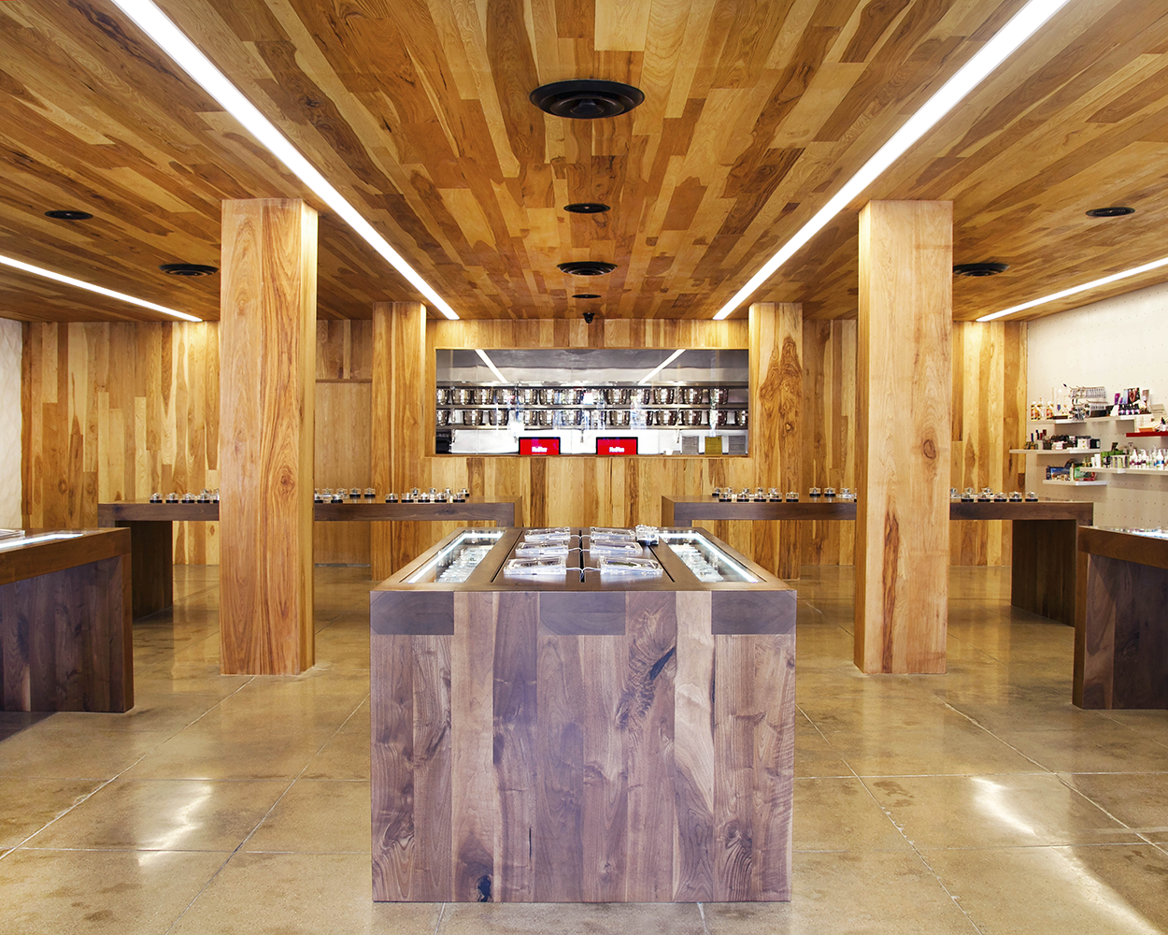
Introduction
(CSE: MMEN)
October 2018
Notes:
Kathy Dickson (might introduce her self as our lawyer since she is known)
Landon
Hi, my name is Landon Dais and I am Government Affairs Manager for MedMen. I’m responsible for managing our outreach and relationships with government entities, trade associations and communities in New York. Prior to coming to MedMen I was an attorney at the primer Long Island Law Firm Forchelli, Deegan and Terrana, and was the Political Director MPP. I have over 15 years of community affairs, political affairs, legal and real estate experience. I am a graduate of Morehouse College, Columbia University MSRED program, and Hofstra Law School. My father was raised in Hempstead NY, and my mother is a graduate of Hofstra Law School. I have deep roots in Long Island.
Here is our senior team that will be leading our Boston operations
Rob Esparza, Security Liason
Dr. Gagandeep Puar PharmD – North Hempstead Pharmacists

Slide 2
Who We Are
Fully-integrated in California, Nevada, New York, Florida and Canada
Proven executive team with experience in cannabis
Operating in large, highly-regulated, medical and adult use markets
Robust compliance and security operations with track-record across the supply chain
Industry leading human capital with over 950 employees
Notes:
Landon
We are the nation’s leader in legal cannabis operation and investments.
We operate 19 facilities in CA, NV, NY, FL and Canada
We employ over 950 people across the country, about 20 employees at each retail location.
We only operate in well-regulated, transparent markets where patients and customers feel safe and secure.
We focus on compliance, and bring institutional best practices from analogous industries into the marijuana space.
This is not our first rodeo, we are experienced operators and have a tried and tested retail model that we bring to any market where we operate.

Slide 3
Why North Hempstead and the Manhasset Neighborhood?
Notes:
Landon
Introduction (position, education and purpose of meeting)
Currently, we are already located in North Hempstead. However, we are simply seeking to re-locate our current facility to Manhasset.
We were particularly drawn to to Manhasset because we want to better serve the majority of our current clients. Currently 62% of our current clients are in Manhasset and Great Neck, and 73% of our clients are from the North Shore.
Our average customer is from the North Shore and is over the age of 50
Cancer is the top qualifying condition for our clients. As you know Manhasset is within in a cancer cluster.
On average we serve 50 patients a day
MedMen wants to be a part of the North Shore for its unique, and dynamic culture which seeks high quality stores and committed community partners
The proximity to medical research, quality medical care, and research institutions is aligned with our vision to destigmatize marijuana and improve access to Medical Marijuana
We are also excited to partner with the Manhasset Civic Association
MedMen is committed to blend in with the characteristics of the neighborhood
MedMen is a value add to the community that will attract the right people to the area

Slide 4
Security
Nation Leading Security Systems
Audible Alarm, Silent Alarm, Vibration Sensors
Video Surveillance 24/7
Barriers to Entry
Visitor Control
At Least Two Security Guards for Hours of Operation
Security Perimeter Walk Arounds
Illuminated Exterior
No infractions across our 19 facilities
Notes:
Rob Esparza
I am the Law Enforcement Senior Manager at MedMen. As a Community Outreach Coordinator, Rob is responsible for developing, managing and training Domestic and International Law Enforcement professionals regarding MedMen’s unique products and processes.
I am a retired member of the Los Angeles Police Department (LAPD), where he received the Police Medal for Bravery. I have 32 years of corporate security experience and expertise to the MedMen Global Security team. My experience includes investigations, physical security, and risk and threat assessments for Apple Inc., Sony Pictures Entertainment, and 21st Century Fox. I am a valued advisor on the board of the Nevada Impaired Driving Prevention Task Force, the first and only partnership between a task force of this scope and a cannabis company.
Given my experience, I understand community policing and best practices, and I use that approach when building our security plans and partnerships in all of the communities where MedMen operates.
To give you a brief overview of some of our security systems, we use Video cameras to blanket our facility. The cameras will be placed to ensure there are no blind spots or diversion of product. The video cameras are monitored 24/7 at our Security Operations Center.
We also devise multiple barriers to entry to ensure only qualified customers can enter our facility. We will have at least two security guards at the dispensary during all hours of operation, and they will take turns performing perimeter walks around the premises to ensure there is no loitering or consumption in the surrounding area.
We’ve found that in the communities where we operate, the surrounding businesses and residences appreciate us being there because it adds an additional layer of security protection with our video camera monitoring and perimeter walks.
We also assign a Security Liaison in each City where we operate to work directly with local police to educate them on our operations. In Los Angeles and Vegas, the police forces have reached out to us proactively to train them on marijuana retail operations.

Slide 5
Customer Flow and Management
Mitigation and Prevention Strategy
No Consumption on Premises or Parking Lot
Loitering Not Allowed
Child-Proof Packaging
Good Neighbor Practices
Notes:
Rob Esparza
The safety and security of our customers, staff and the surrounding community are our primary priority.
To ensure that only qualified customers enter the premises, we do the following:
All customers are greeted by a hospitality associate who checks their ID at check-in desk and confirms they are registered as a patient or care-giver in the NY state PMP System
Only certified patients / caregivers that are checked in at the front, can purchase product during their visit. If they are not checked in, they cannot purchase
All of the product is stored in a vault, so product can only leave the premises once a customer requests it from a trained hospitality associate and the purchase is reviewed and supervised by a pharmacists, that person retrieves it from the vault, and then checks them out at the check out kiosks and places the product in an exit bag.
We do not keep any product on the sales floor. Our display tables only hold dummy products, nothing with marijuana.

Slide 6
Pharmacists
New York State Leading Pharmacists Team
Highly Trained Pharmacists Always on Site
Strong Compliance Controls
Patients Must Have a Qualifying Condition
Limited Types of Products for Sale
Pharmacist Supervises all Transactions
Ensures all Patients are in PMP System
Operation Hours 10 am – 8 pm
North Hempstead Facility Serves 50 Patients a Day
Notes:
Dr. Gagandeep Puar PharmD
I am the head Pharmacist at the North Hempstead Lake Success medical marijuana facility. I am a graduate of St. John’s University School of Pharmacy. Prior to joining MedMen I was a pharmacists at CVS Health for 5 years.
Currently, the Lake Success facility treats approximately 50 patients a day. Our hours of operations are 10 am to 8 pm and we are open 7-days a week. The majority of my patients are from the North Shore. In order to be a qualified patient you must have one of the following qualified conditions: Aids / HIV, ALS, Cancer, Chronic Pain, Epilepsy, Huntington Disease, MS, Inflammatory Bowel Disease, Parkinson’s, Seizures, Neuropathies, PTSD, and Opioid Replacement.
This is my first job in the medical marijuana field but I have been following the industry closely and have always been interested in the usage of marijuana for medicinal purposes to offset the usage of pharmaceuticals. Marijuana provides relief for patients in a manner causing minimal side effects and rarely induce or exacerbate commodities. Medical marijuana is helping to stop Americas addiction to opioids, which is hurting communities like North Hempstead.

Slide 7
Compliance
Culture of Compliance
Compliance Team
Quality Assurance Team
Process Writing Team
Compliance Checklists
Monthly Audits
Seed-to-sale Tracking Software
Regular Inventory Reconciliation
No Prior Enforcement Action Across 19 Facilities
Security And Inventory Control
Comprehensive Standard Operating Procedures
Employee Training And Monitoring
Notes:
Landon
Ed Linetshkiy Director of Compliance
Responsible for ensuring MedMen’s national operations and assets are in compliance with state and local regulations
Oversees all department functions, which include auditing, licensing, operational support and surveillance
Comes from financial securities compliance
MedMen prides itself in setting the gold standard for compliant operations.
We have a 10 person legal and compliance team that is responsible for developing our Standard Operating Procedures, audits and daily checks to ensure we are always in compliance with state and local regulations.
We utilize seed-to-sale tracking software so there is no diversion of product, we do regular inventory reconciliations, and collaborate with the retail team on training all employees before they start working the sales floor.

Slide 8
Retail Operations
Regulated, Unique Retail
Transparent Operations
Open Floor Plan
Sleek, Tasteful Design
Trained Employees
Notes:
Landon
MedMen prides itself in its unique retail model and best-in-class retail operations. Here are some pictures of our Manhattan store.
Consumers that are only ages 21 and older, after being checked in at the front by our security professionals, and confirming their qualified credentials, will be able to navigate the sales floor and consult with sales associates or pharmacists about products. Each location has iPads throughout the sales floor so patients can educate themselves on the products, and we have trained sales staff also walking around to assist patients.
We will have at least 12 sales associates at a time at this location to educate our consumers. We recruit from the local community and want our staff to reflect the community. We offer competitive wages and health benefits to our staff.
MedMen believes in robust training program for our employees and crafting education campaigns to help our customers, especially those that are new to medical marijuana. We do extensive training and teaching around proper dosing of product, first time user consumer trainings, safe consumption trainings, and how to safely store product at home away from underage family members.
Under retail operations, we ensure that only trained employees have secured access to the product. There are staff that are responsible for retrieving product from our secure inventory vault each time a sale occurs. All product is tracked through our seed-to-sale and Point of Sale software to ensure there is no diversion of product.
We pride ourselves in our hospitality and community engagement program, where we build strong relationships with the communities where we operate, we have a good neighbor responsibility program which entails…

Slide 9
Community Engagement
Serving Communities
Community Relations Manager
Community Education, &Tours
Expungement Clinics
Chamber of Commerce Members
Trade Association Members
We Do Care – Neighborhood Responsibility Program
Examples of Non-Profit Giving and Partnerships
Equity and Opportunity: A Job Fair and CORI Sealing Clinic for a New Economy
MPAA
PRIDE
Van Ness Recovery House
Friends of Spring Street Park
Notes:
Landon
<<What are the non-profits in the Manhasset community that we would like to engage with?>>
We are proud of our partnership with UFCW in CA and NY
We approach community engagement in two ways:
1) MedMen seeks to recognize and address the disproportionate impact the War on Drugs had on communities through grants to established community based organizations that conduct record expungement clinics, job training and job placement services.
2) We seek to empower the next generation of leaders to be successful through partnerships with youth development organizations, college readiness programs and vocational training.
3) Educate the community on the benefits of medical marijuana and how it can bring the relief to many in their community
Expungement clinics
Throughout the country, MedMen has supported partnerships re-entry programs, non-profit organizations serving HIV impacted patients, residential drug and alcohol treatment facilities, and civil rights community-based organizations
We look forward to working with the Manhasset Civic Association

Slide 10
Interior Renderings
Notes:
<<These are from Boston?>>
Landon
In these renderings you can see that we would create:
An open floor plan, that is sleek and modern with a well-designed aesthetic
We use three different types of wood to create a warm and welcoming feeling
MedMen is an ultra luxury Medical Marijuana company often compared to Apple or Barney’s of Medical Marijuana

Slide 11
Thank You!
For additional information, please contact:
Landon Dais
Government Affairs Manager
Landon.Dais@MedMen.com
Notes:
Tough Questions
Lead with our experience and then talk about studies
Property Value decreases: Two studies, in University of Mississippi and WI, shows communities that allow for cannabis have seen 3-4% increase in property values. As we have seen in the other neighborhoods operate, such as Beverly Hills, Manhattan, Las Vegas where we are successful, development has happened around them.
Crime: Community becomes safer when a well-secure dispensary is operational in a community with our 24-hour video surveillance. RAND study from May 2018 found this, LMU from October 2017, University of Bologna from January 2017
Loitering:
Adult Use: We plan to support the legalization of Adult—use because it is the right thing to do. The prohibition of Marijuana has caused a greater harm than the prohibition has reduced. Adult-use legalization will lead to safer streets, creates a better public health policy, protects police officers, creates 100s of millions of dollars in tax revenue which in turn will lower municipalities tax liabilities, reduce opioid abuse and is a social justice issue.

